Slide 1
SECTION 5310 GRANT WEBINAR
FY2023 - 2024

Slide 2



Housekeeping
Please stay on mute
Questions

Slide 3
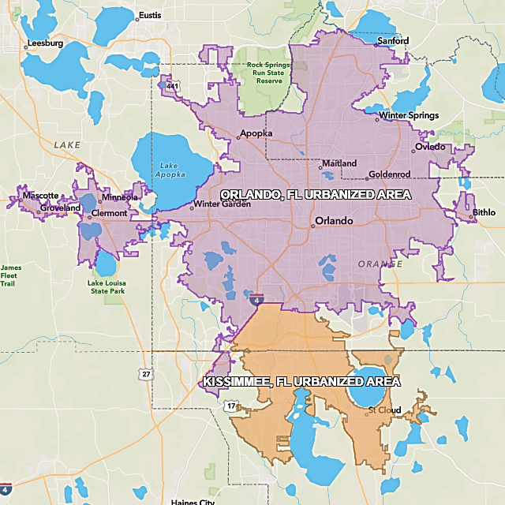
Section 5310
What is it for?
The purpose of the Section 5310 Grant Program is to improve mobility options for seniors and individuals with disabilities.
Who is it for?

Slide 4
Last Year’s Accomplishments
6 Agencies Awarded
Approximately 44,457 one-way passenger trips provided
Approximately 3,826 seniors and individuals with disabilities served
21 Vanpool vehicle leases funded
Adult Day Care/Socialization
Teaching Special Skills
Workforce Placement
Shopping Trips/Medical Appointments

Slide 5
Eligible Sub-recipients
Section 5310
LYNX (Urban Area Direct Recipient)
Community Transportation Coordinators
Private Non-Profit Organizations
Private Taxi Companies
Public Transportation Agencies
FTA
FDOT
(Rural Area Direct Recipient)

Slide 6
Eligible Project Types
1. Vanpool Program
LYNX leases the vehicle(s) to your agency to improve mobility of seniors and individuals with disabilities
2. Section 5310 Operating Funds
Limited operating funds, directly associated with the provision of transportation services meeting 5310 program objectives (salaries, fringe benefits, fuel expenses, etc.)
3. Vehicle Transfers
LYNX may have retired vehicles available to be transferred to agencies for uses in-line with the Section 5310 requirements
See Application Manual for Additional Information

Slide 7
LYNX Section 5310 Program Priorities
Vanpool vehicles are the highest priority for this grant opportunity
Additional priorities:
    Maximizing transportation resources available to seniors and individuals with disabilities in the Urbanized Orlando and Kissimmee areas.
    Providing for the special needs of seniors and individuals with disabilities for whom transportation services are unavailable, insufficient or inappropriate.
Funding is available for 1 year

Slide 8
Vanpool Program
LYNX Agency Vanpool - $690* per vehicle, per month (includes Maintenance, Insurance and Roadside Assistance).
  If agency provides insurance (with Enterprise approval) - $525* per vehicle, per month
  Rate subject to change
Current vehicle models available
  10 Passenger Ford Transit van
  12 Passenger ADA Turtle Top van
  15 Passenger Ford Transit van
  Specific floorplan requests to suit your operations will be considered
Managed by LYNX Contractor Enterprise
50 / 50
*Additional agency costs include fuel, tolls, or parking if applicable

Slide 9

Operating Program
Operating
This is a reimbursement grant. LYNX will reimburse 50% of Transportation Operating expenses incurred during period of award. All agencies must provide back up documentation for expenses to receive reimbursement.

Slide 10

Vehicle Transfers
LYNX may have retired vehicles available to be transferred to agencies for uses in-line with Section 5310 requirements
  100,000 + mileage
Agency is responsible for operating vehicle for at least one year
Agency is responsible for covering all associated operating expenses
Reporting requirements for one year after vehicle is received

Slide 11

Award Requirements
Regional Coordination Efforts
LYNX’s Human Services Transportation Plan (HSTP)
Reporting
Monthly operating data submissions
Monthly Invoices
Quarterly progress reports
CTC Reporting and Annual Inspection
Reviews and Oversight
Record Keeping and Audits
Virtual Desktop Reviews
Pre and Post-Award Monitoring
Vehicle Use
Vehicle maintenance requirements
Transport seniors and individuals with disabilities

Slide 12
Checklist
Task | Deadline | Additional Info
Application Questions | November 11, 2022 | Contact Emily Davis - edavis@golynx.com
Coordination with CTC | November 11, 2022 | Contact Selita Stubbs – sstubbs@golynx.com
Secured Portal Link Request | November 18, 2022 | Applications can only be submitted through Link
Application Submission | November 23, 2022 | Link expires at 5:01 PM – no exceptions!
Cone of Silence | TBD | Application submission – Letters of Intent
Recommendation to Award | Winter 2022 | LYNX Board of Directors

Slide 13
Project Selection
LYNX will provide a multi-agency evaluation committee access to the applications and the evaluation criteria. It will be up to the evaluators to read the applications and score them accordingly.
    Documents (15 points)
    Budget (25 points)
    System Description (14 points)
    Proposed Project Description (30 points)
    Overall Impression (16 max points)
    Max Score: 100 points
Internal LYNX staff will be responsible for two rankings:
  Prior Sub-recipient Risk Assessment
  Application Fact Sheet

Slide 14
Tips and Tricks
Maps requested must be in COLOR
Provide two copies of required Forms:
  Excel Format
  PDF Format Signed
The Authorized Representative signing forms must be the same person designated in the Board Resolution
Read the LYNX Transportation Disadvantaged Service Plan for Exhibit C
Do not copy and paste old applications – show program growth
See the new SF-424 guide for directions

Slide 15
Required Excel Documents
Form 1: Annual Operating Data
Support for Budget and Fact Sheet
Data from July 1, 2021 – June 30, 2022
Verifiable data – consistency with AOR preferred if applicable
Form 2: Funding Request
Vanpool vehicles - only12 passenger vehicles have wheelchair access
Unit cost the same regardless of vehicle type
Operating assistance requests must comply with Grant Manual Eligible Projects Section
Grant request - 50% of the Total Project Cost
  Form 3: Local Match
  Form 3: Local Match
  Sources and amounts for the Local Match
  Other funds received for transportation
  Local Cash Contribution amount from Form 2 must match Total Local Match
  Form 4: Fact Sheet
  1st column - Form 1auto-populates
  2nd column - calculations
  3rd column - projections
  Form 5: Vehicle Inventory
  Current vehicle inventory
  Anticipated/requested vehicles

Slide 16
Application Submission
Application must submitted via the Secured Portal
Secured Portal Link request deadline:
    November 18, 2022
    Contact Emily Davis edavis@golynx.com
Application Submission Deadline:
  November 23, 2022
  We reccomend to submit at least 24 hours in advance

Slide 17
Contact Us
If you are interested in applying to LYNX for Section 5310 funding, or would like more information on the program, please contact us at:
Emily Davis – 5310 Grant Representative
Human Services Transportation Analyst
edavis@golynx.com
Selita Stubbs – CTC Representative
Senior Manager of Mobility Services
SStubbs@golynx.com

Slide 18


