Slide 1
Section 5310 Grant Workshop
Fiscal Year (FY) 2024-2025

Slide 2
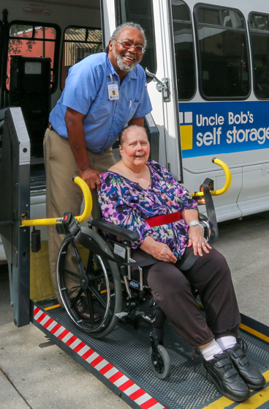
Section 5310
Purpose:
To improve mobility options for seniors and individuals with disabilities.
Service Area:
Urban areas of Orlando
Urban areas of Kissimmee

Slide 3
Eligible Sub-Recipients
LYNX
Community Transportation Coordinators
Private Non-Profit Organizations
Private Taxi Companies
Public Transportation Agencies
FTA
FDOT
Direct
Recipient
(Rural areas)
Direct
Recipient
(Urban areas)

Slide 4
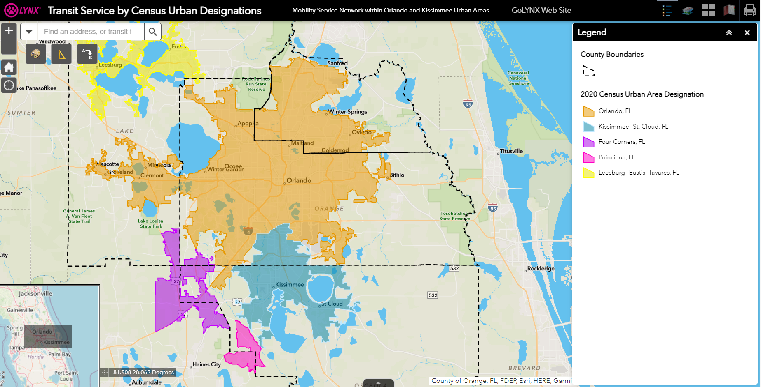
Is my agency eligible?
Click here to type origin & destination addresses
Transit Service by Census Urban Designations (arcgis.com)

Slide 5
Eligible 5310 Projects
Vanpool Program
Operating Funds
Vehicle Transfer

Slide 6

Vanpool Program
Managed by LYNX contractor: Enterprise
Funding available for 1 year
Bus floor plans:
  10 passenger Ford Transit Van
  12 passenger wheelchair ADA accessible
  15 passenger Ford Transit Van
    * Specific floorplan requests to suit your operations will be considered.
Includes:
  Maintenance
  Preventative maintenance every 6,000 miles at one of our approved vendors
  Insurance
  Up to $1,000,000 per occurrence and $250,000 in personal liability
  Roadside Assistance
  24 hour assistance

Slide 7

Vanpool Program
LYNX Agency Vanpool:
$690* per vehicle, per month
If agency provides insurance (with approval), $525* per vehicle, per month
*Additional agency costs include fuel,
tolls, or parking if applicable.
*Rate subject to change.

Slide 8
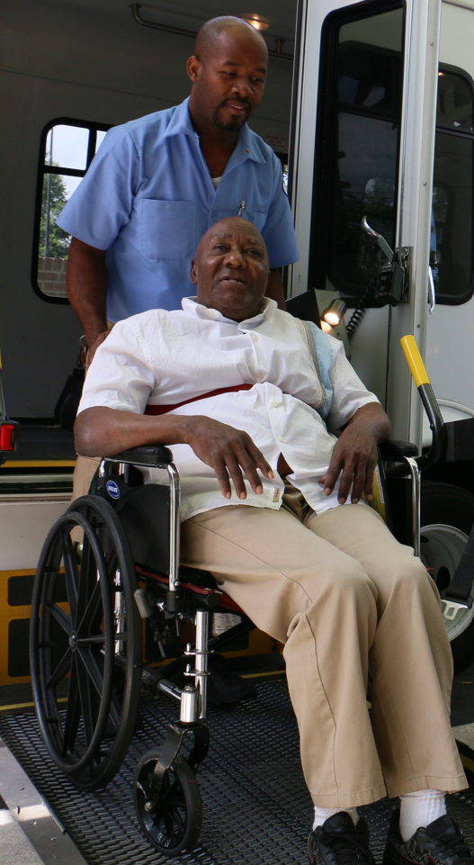
Operating Funds
LYNX will reimburse 50% of transportation operating expenses incurred during the award period .*
Examples:
  Salary
  Fringe benefits
  Fuel for the Vanpool vehicle
  Among others
*Back up documentation
required for reimbursement.

Slide 9
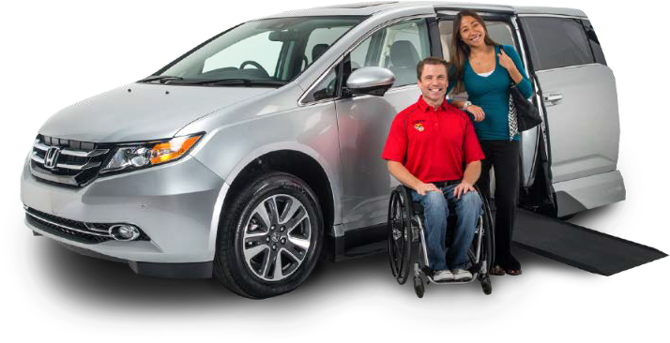
Vehicle Transfer
LYNX may have retired vehicles available to be transferred to agencies for use in-line with Section 5310 requirements.
Agency will be responsible for:
  operating the vehicle for at least one year
  all operating expenses
Requires FTA approvals

Slide 10


Award Requirements
Regional Coordination
Efforts
LYNX’s Human Services Transportation Plan (HSTP)
Reviews and Oversight
Record Keeping Audits
Virtual Desktop Reviews
Pre/Post Award Monitoring
Reporting
Monthly Operating Data
Monthly Invoices
Quarterly Progress Reports
CTC Reporting & Annual Inspections
Vehicle Use
Maintenance Requirements
Transport seniors and individuals with disabilities

Slide 11

Application Schedule
Major Task | Dates
Grant Workshop | July 21, 2023
Period of Questions & Coordination with CTC | July 24 – August 4, 2023
Applications Due | August 25, 2023
Recommendation to award | Winter 2023
Pre-Monitoring Process & Notice to Proceed | Summer 2024
Period of Award | October 1, 2024 to September 30, 2025

Slide 12
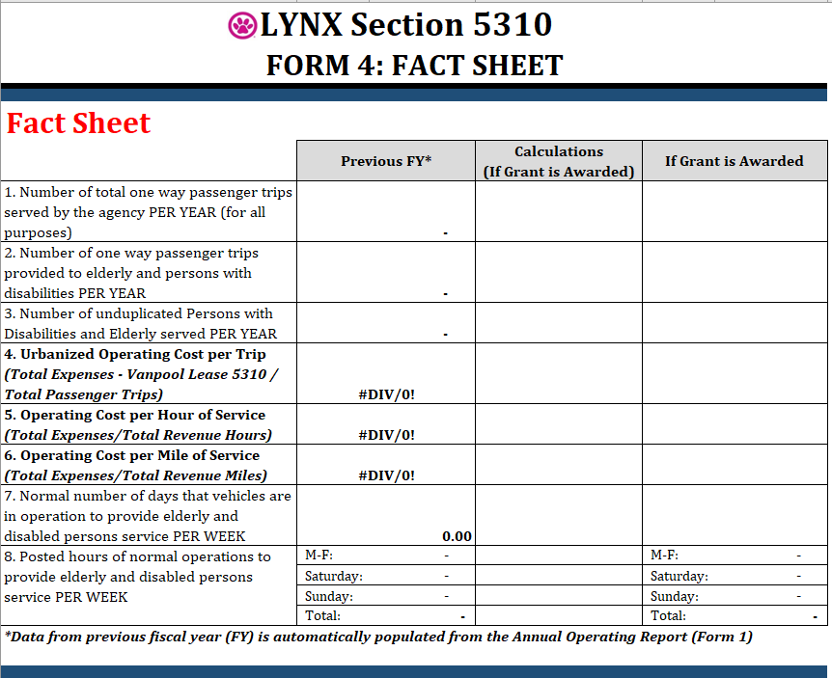
Project Selection
Multi-agency:
A multi-agency evaluation committee will review the applications and score them based on the evaluation criteria.
Internal (LYNX):
Subrecipient risk assessment
Fact Sheet
Criteria:
  Documents (22 points max)
  Agency Information (2 points max)
  System Description (18 point max)
  Budget (25 points max)
  Proposed Project (28 point max)
  Overall Impression (5 points max)
  Max Score: 100 points

Slide 13
Required Documents
Form 1: Annual Operating Data (sections 1-5)
Support for Budget and Fact Sheet
Data from July 1, 2022 through June 30, 2023
Form 2: Funding Request
Vanpool: Same unit cost regardless of vehicle type
Operating Assistance: request must comply with Grant Manual’s Eligible Project Section
Grant request: 50% reimbursement of the total project cost.
Form 3: Local Match
Sources and amounts for the Local Match
Other funds received for transportation
Local Cash Contribution amount from Form 2 must match Total Local Match
Form 4: Fact Sheet
1st column – auto populates
2nd column – calculations
3rd column – projections
Form 5: Vehicle Inventory
Current vehicle inventory
Anticipated/requested vehicles

Slide 14
Tips and Tricks
Maps must be in COLOR.
Provide two copies of required Forms: Excel & PDF format (signed).
The Authorized Representative signing forms MUST be the same person designated in the Board Resolution.
Read LYNX’s Transportation Disadvantaged Service Plan.
Do not copy and paste information from old applications!

Slide 15
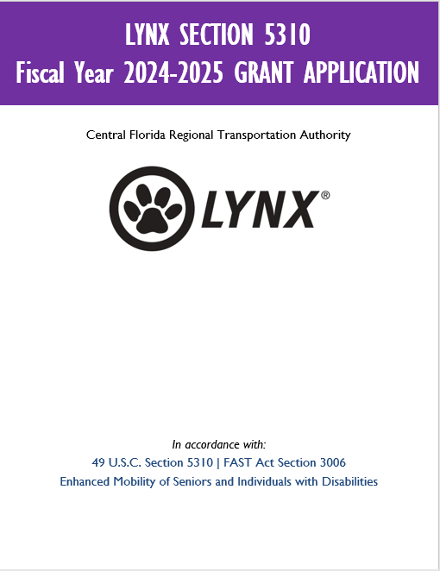

Application Submission
Request, by email, a secured portal link no later than August 18, 2023 to:
      Brenda I Garcés
      BGarces@golynx.com
Applications must be submitted through a secured portal by the deadline:
    August 25, 2023
    by 5:00 pm

Slide 16

Contact Us
For more information on the program, please contact:
Brenda I Garcés – LYNX
Human Services Transportation Analyst
BGarces@golynx.com
Selita Stubbs – LYNX, CTC
Senior Manager of Mobility Services
SStubbs@golynx.com
Luis Benitez – Enterprise
Enterprise Contractor
LBenitez@golynx.com

Slide 17


FTA 5310 Program | Public Transportation in Orange, Seminole & Osceola (golynx.com)

