Slide 1
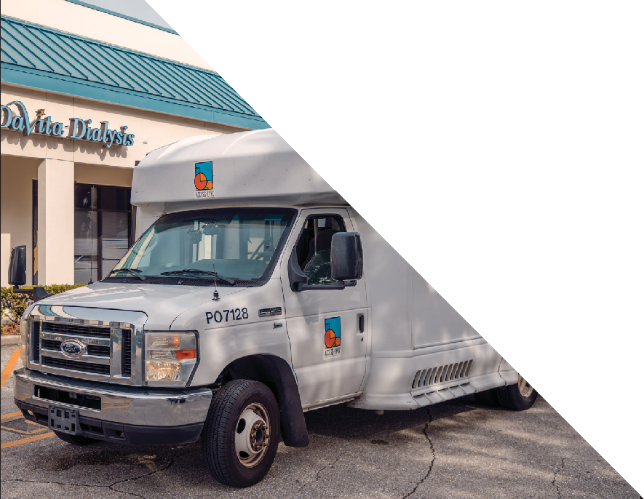


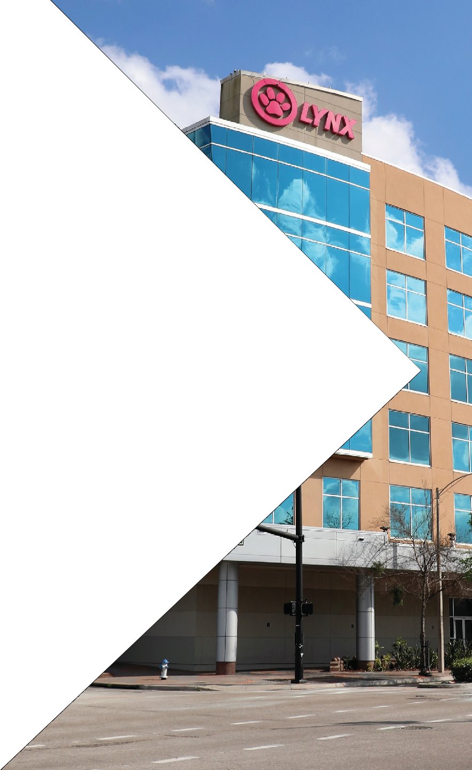
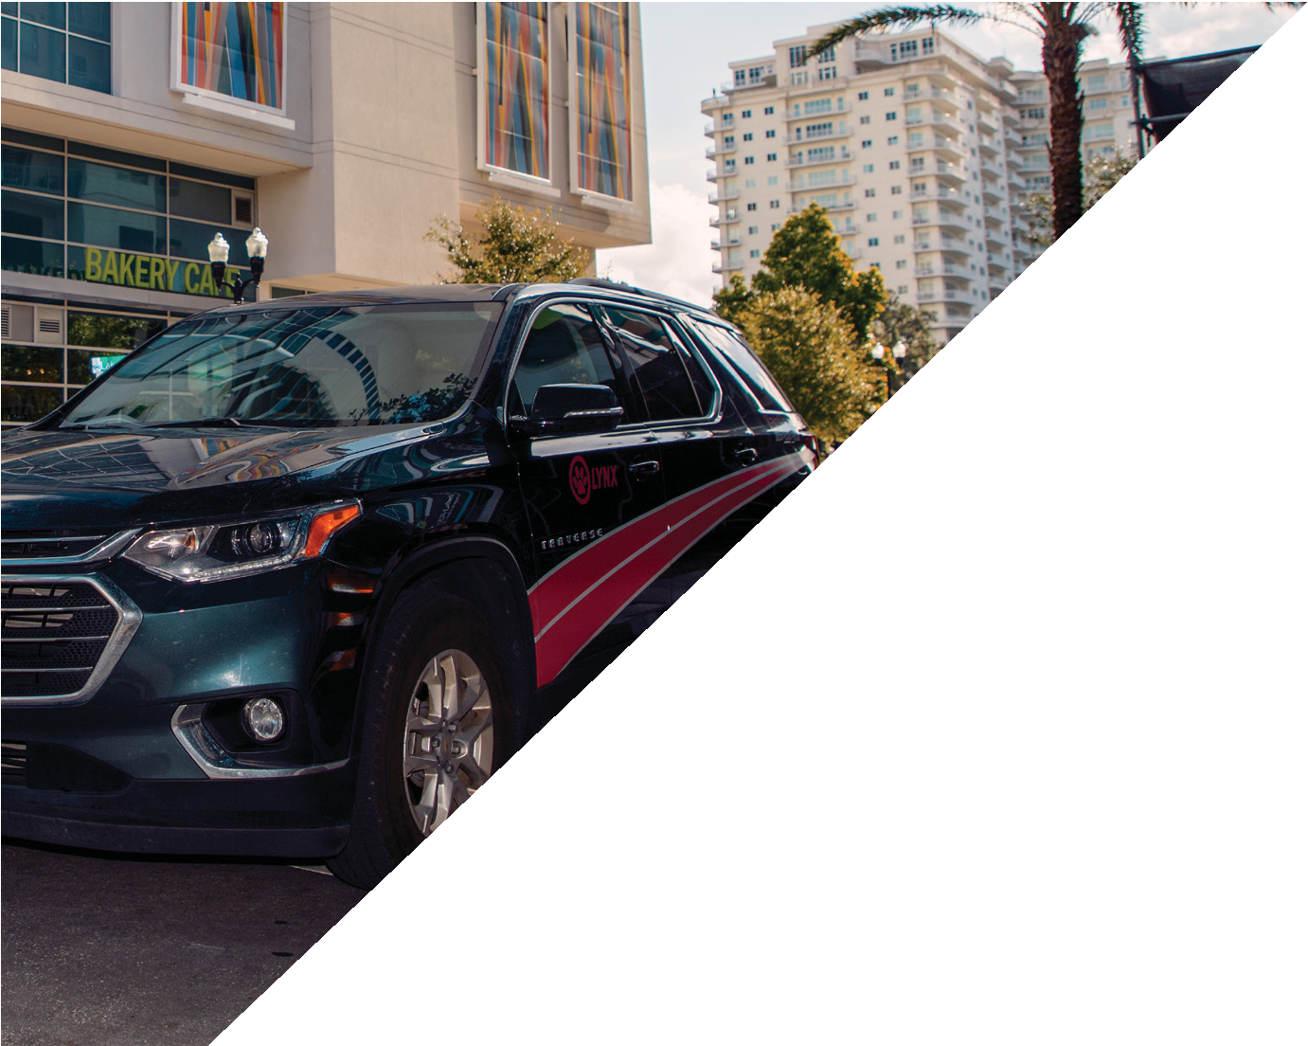
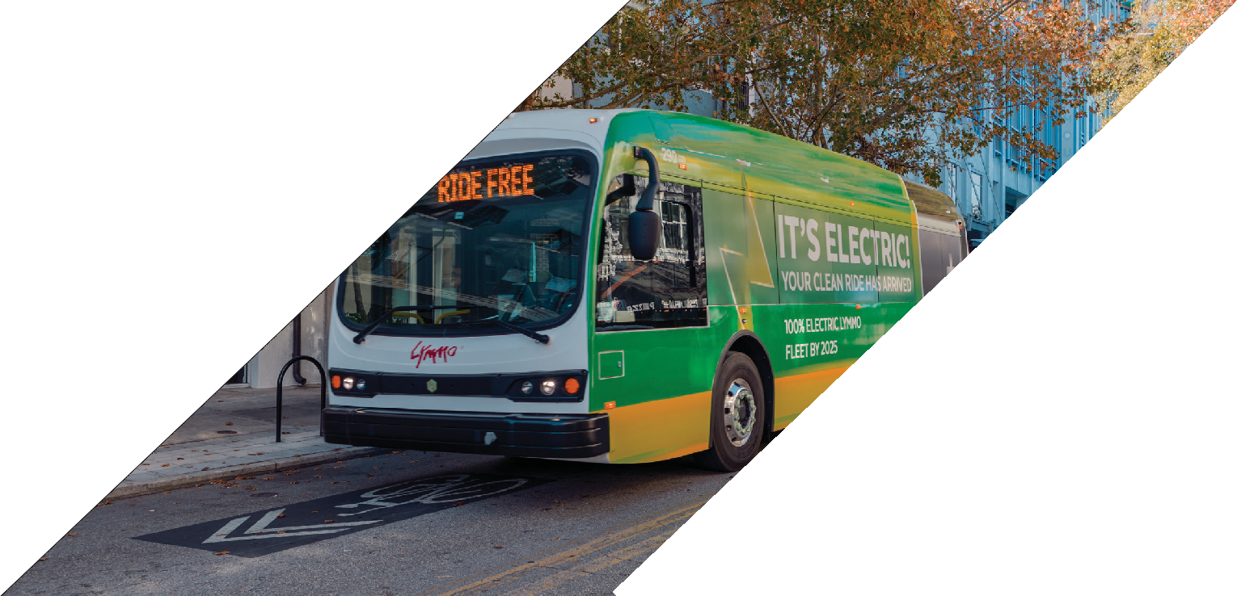
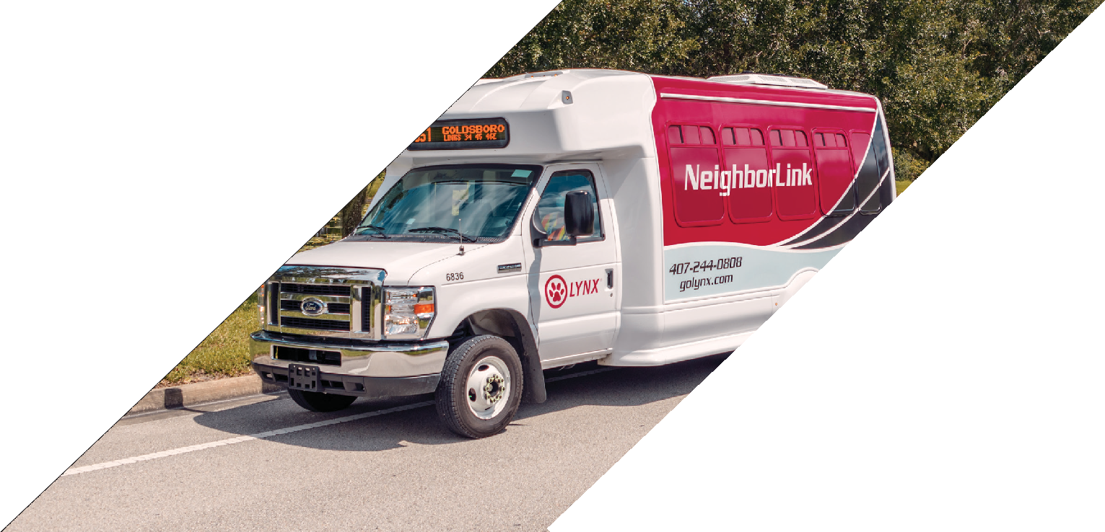

LYNX Section 5310 GRANT Workshop
Fiscal Year (FY) 2025-2026

Slide 2
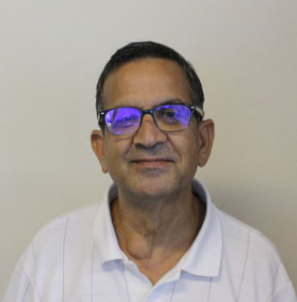
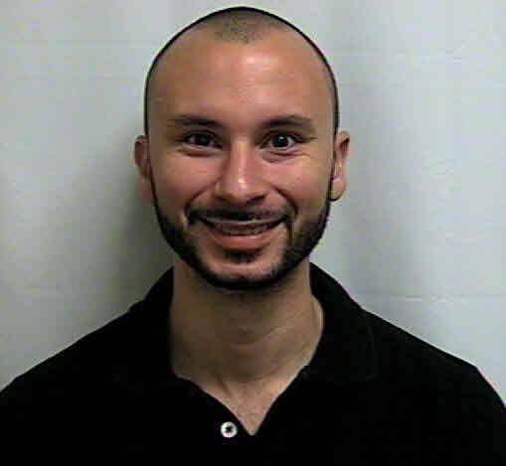
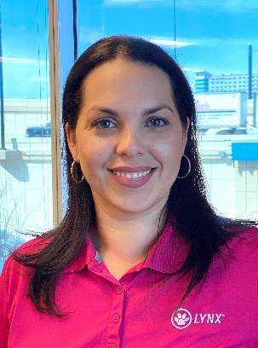

LYNX Section 5310 Program contact information
Prahallad Vijayvargiya
Senior Manager Grants
LYNX
PVijayvargiya@golynx.com
Luis Benitez
Branch Manager
Commute with Enterprise
luis.benitez@em.com
Brenda I Garces
Human Services Transportation Analyst
& Grant Writer
LYNX
BGarces@golynx.com

Slide 3
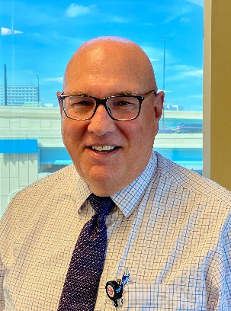
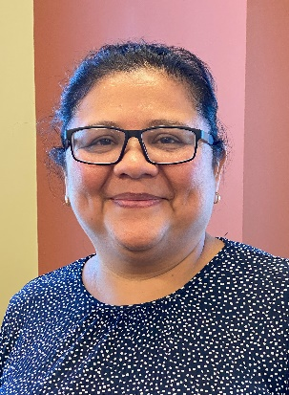
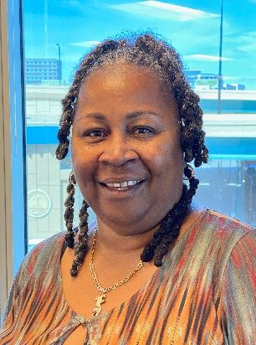
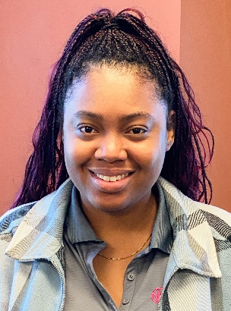

Community Transportation Coordinator (ctc) contact information
Norm Hickling
Director
CTC and Mobility Services
LYNX
NHickling@golynx.com
Maria Numpe
Paratransit Eligibility and Compliance Reporting Supervisor
CTC – LYNX
MNumpe@golynx.com
Selita Stubbs
Senior Manager Mobility Services
CTC – LYNX
SStubbs@golynx.com
Ketty Salam
Compliance Support Coordinator
CTC – LYNX
KSalam@golynx.com

Slide 4
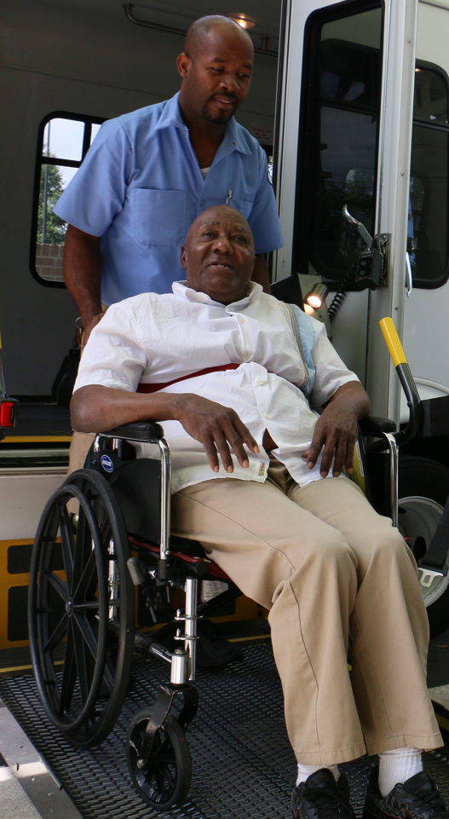
PROGRAM OVERVIEW
Section 5310:
Improving mobility options
Service Area:
Urban areas of Orlando
Urban areas of Kissimmee
for seniors and individuals
with disabilities.

Slide 5
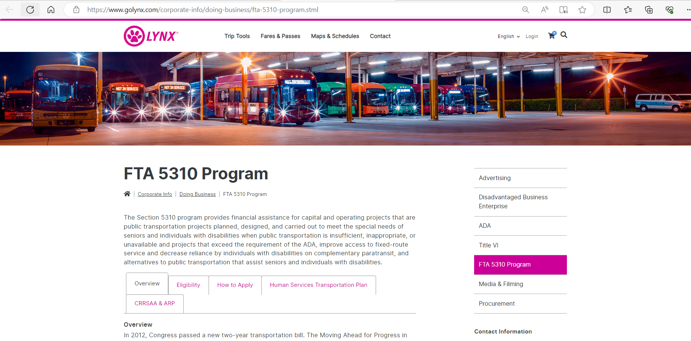
Program Overview

Slide 6
SECTION 5310 FUNDING
LYNX
Community Transportation Coordinators
Private Non-Profit Organizations
Private Taxi Companies
Public Transportation Agencies
FTA
FDOT
Direct
Recipient
(Rural areas)
Direct
Recipient
(Urban areas)
This program is funded in part by the Federal Transit Administration (FTA) as authorized under 49 U.S.C. 5310 (CFDA 20.521).

Slide 7

Requirement: Transportation Disadvantaged coordination contract
Agencies soliciting federal award funds must:
  Maintain an active contract with the CTC
    Rule Chapter 41-2.002:“A written contract between the Community Transportation Coordinator and an agency who receives transportation disadvantaged funds and performs some, if not all, of its own transportation services, as well as transportation services to others, when shown to be more effective and more efficient from a total system perspective. The contract reflects the specific terms and conditions that will apply to those agencies that perform their own transportation, as well as joint utilization and cost provisions for transportation services to and from the community transportation coordinator.”
  Complete the monthly and Annual Operating Report
  Complete all required on-site/vehicle compliance inspections

Slide 8
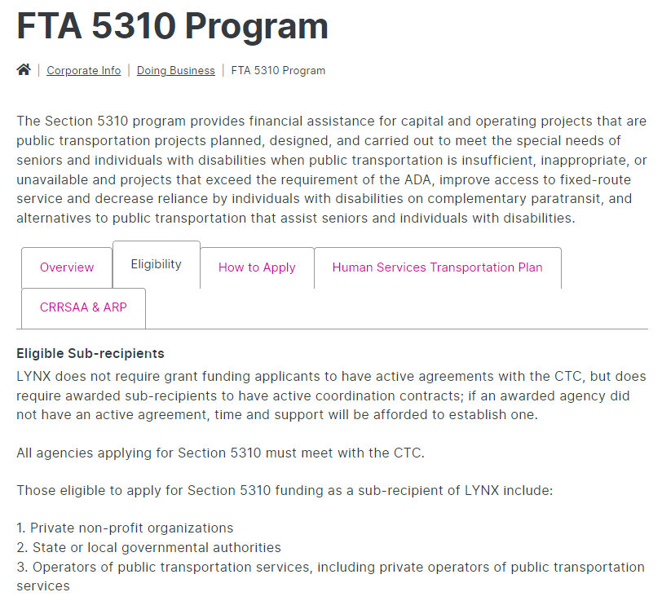
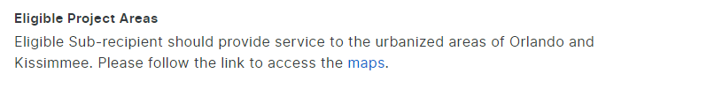
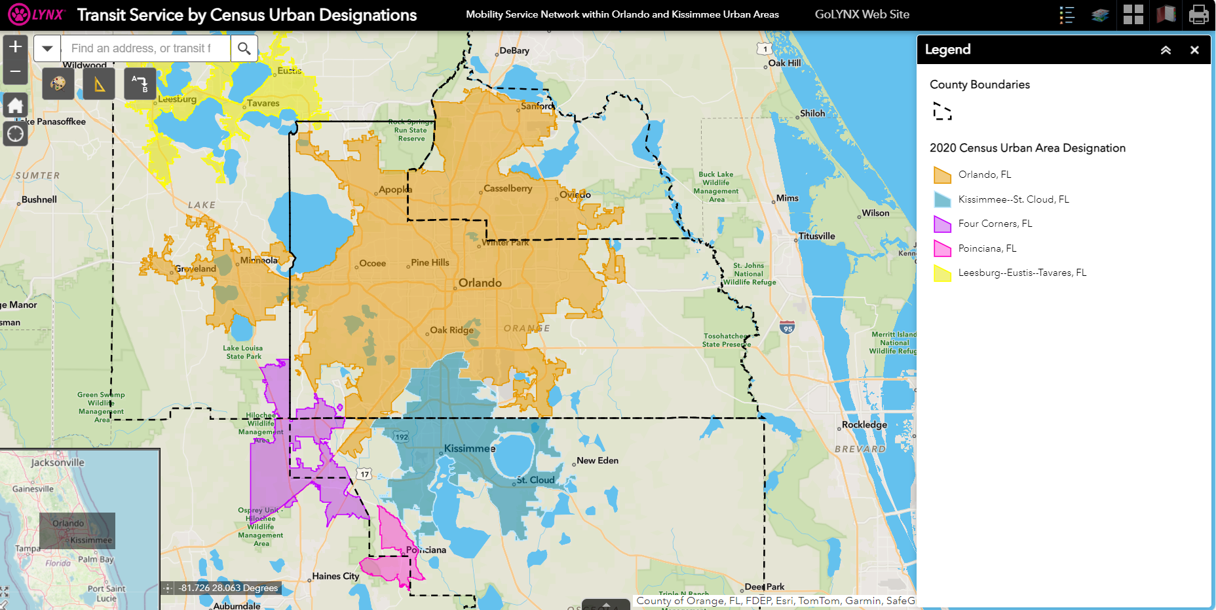
IS MY AGENCY ELIGIBLE?

Slide 9
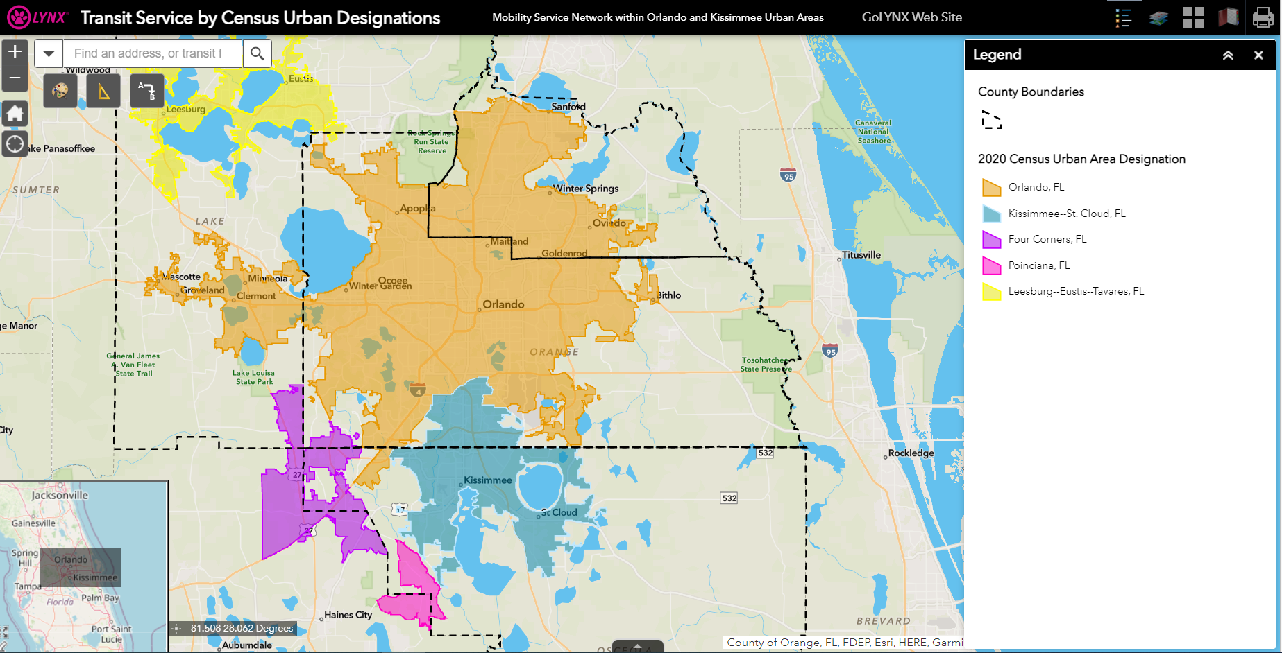
IS MY AGENCY ELIGIBLE?
Click here to type origin & destination addresses
Transit Service by Census Urban Designations (arcgis.com)

Slide 10
ELIGIBLE 5310 PROJECTS
Section 5310
Projects
Vanpool Program
Operating Assistance
Vehicle Transfer

Slide 11


VANPOOL PROGRAM
Funding Available for 1 year
Managed by LYNX’s current contractor: Enterprise
Various bus floor plans (Turtle Top & Vans)
  *Specific floorplan requests to suit your operations will be considered.
Includes:
  Maintenance
  Preventative maintenance every 6,000 miles at one of the approved vendors
  Insurance
  Up to $1,000,000 per occurrence and $250,000 in personal liability
  Roadside Assistance
  24-hour assistance
Reimbursement Program
$690** including insurance
$525** with private insurance and prior authorization
** Rate subject to change.
* Additional agency costs include
fuel, tolls, or parking
if applicable.

Slide 12
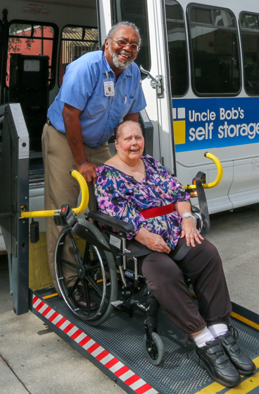
Operating assistance
Reimbursement Program
* LYNX will reimburse 50% of the total transportation operating expenses incurred during the award period.
Examples:
  Salary
  Fringe benefits
  Fuel for the Vanpool vehicle
  Among others
Back up documentation
required for reimbursement.

Slide 13
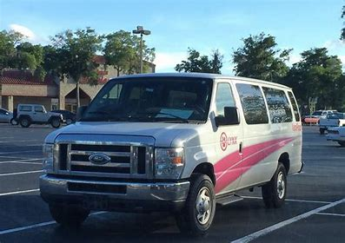
Vehicle transfer
LYNX may have retired vehicles available to be transferred to agencies for
use in-line with Section 5310 requirements.
Agency will be responsible for:
  operating the vehicle for at least one year
  all operating expenses
  completing the Annual Operating Report and the monthly trip reporting (NTD)
Requirements:
  FTA approvals
  Having an active contract with the CTC

Slide 14

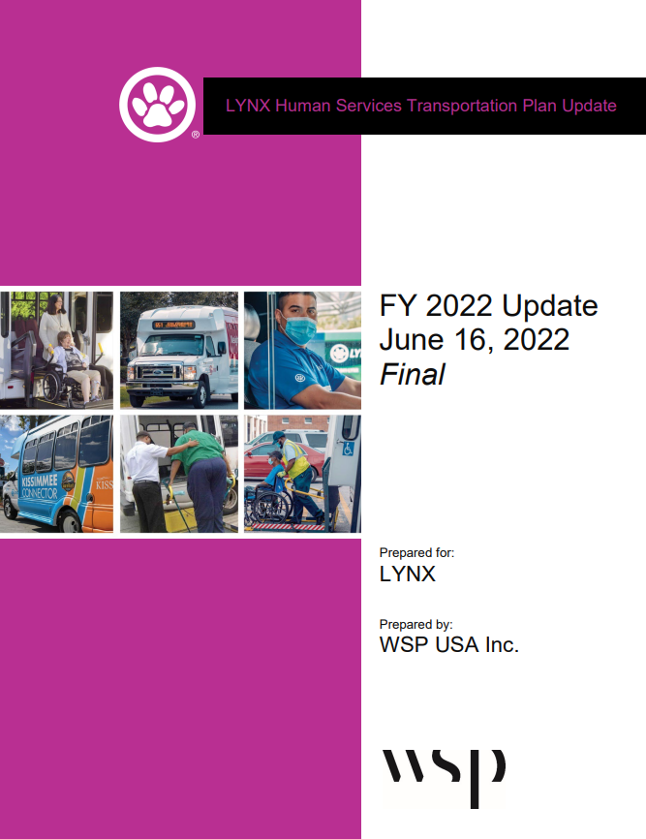
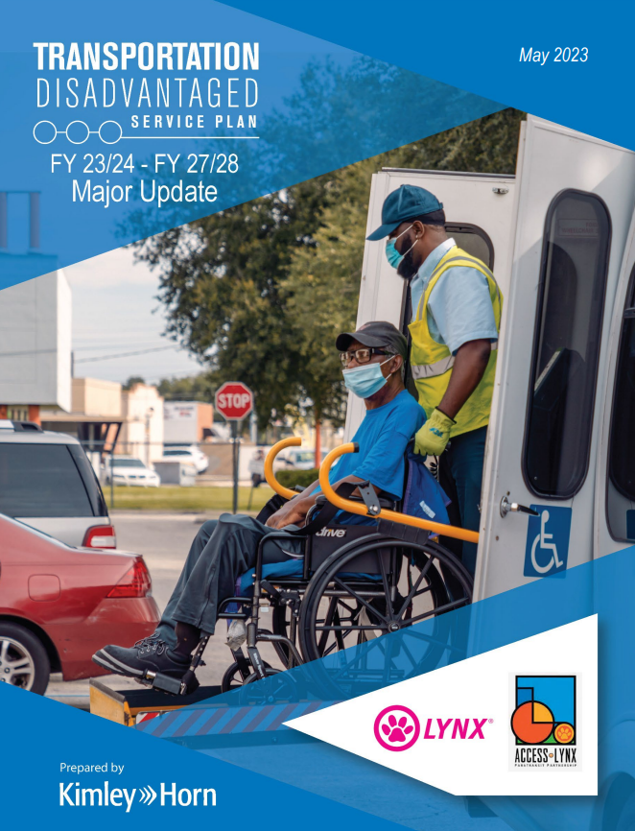

AWARD REQUIREMENTS
Regional Coordination Efforts
LYNX’s Human Services Transportation Plan (HSTP)
Reviews and Oversight
Record Keeping Audits
Virtual Desktop Reviews
Pre & Post Award Monitoring
Vehicle Use
Maintenance Requirements
Transport seniors and individuals with disabilities

Slide 15
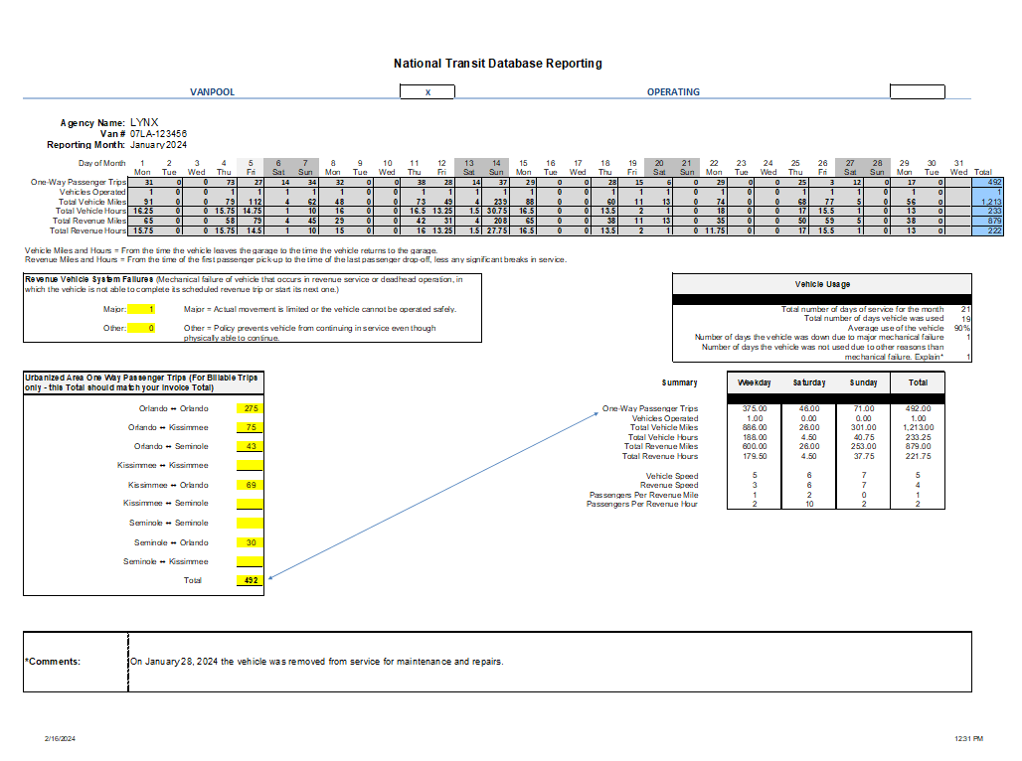
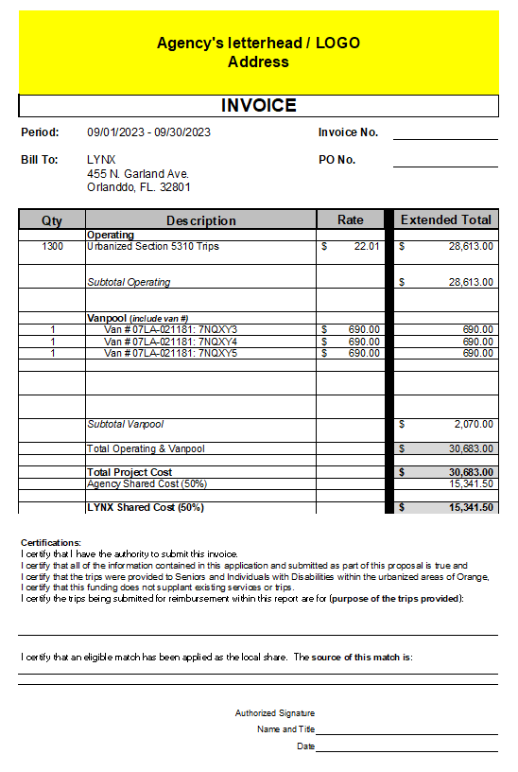
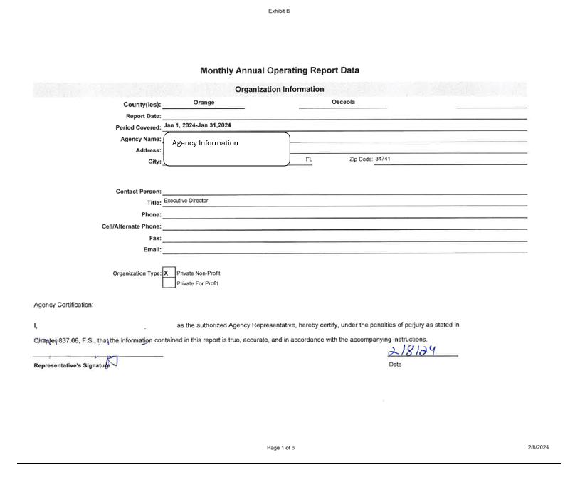
AWARD REQUIREMENTS
Reporting
Monthly Operating Data
Monthly Invoices
Quarterly Progress Reports
CTC Reporting & Annual Inspections

Slide 16

Application Schedule
Major Task | Dates
Grant Workshop | July 11, 2024
Period of Questions & Coordination with CTC | July 15 – July 26, 2024
Applications Due | August 15, 2024
Recommendation to award | Winter 2024
Pre-Monitoring Process & Notice to Proceed | Summer 2025
Period of Award | October 1, 2025 – September 30, 2026

Slide 17
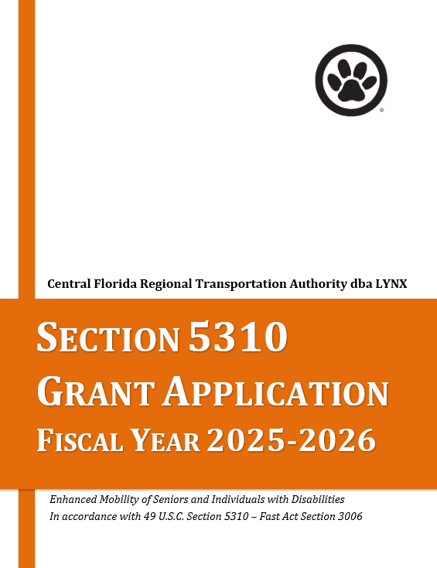
How to apply
Applications must be submitted through a secured portal by the deadline: August 15, 2024
    by 5:00 pm
Request your secured portal access link no later than August 8, 2024
to: Brenda I Garces BGarces@golynx.com

Slide 18
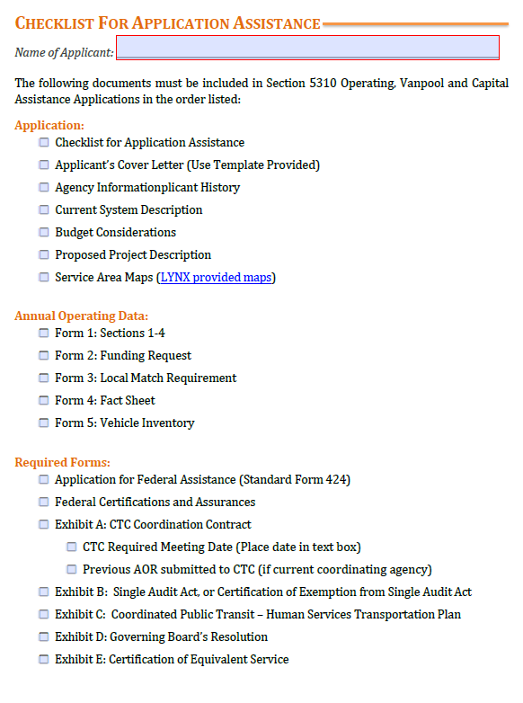
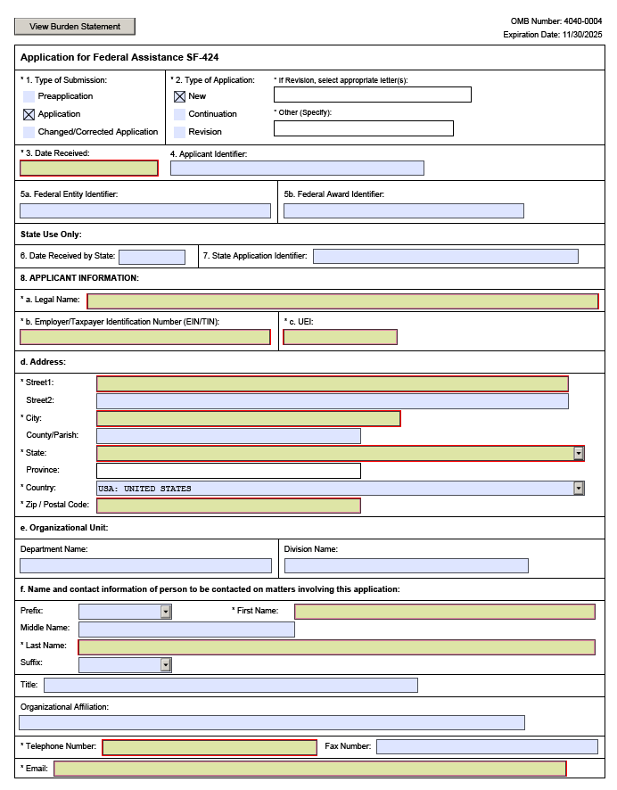
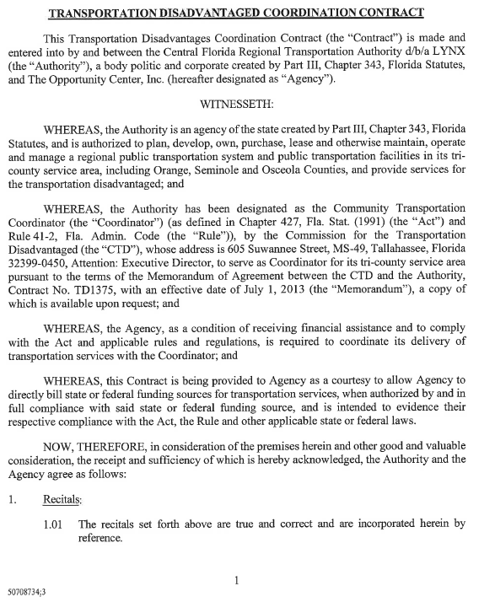
REQUIRED DOCUMENTS: APPLICATION

Slide 19
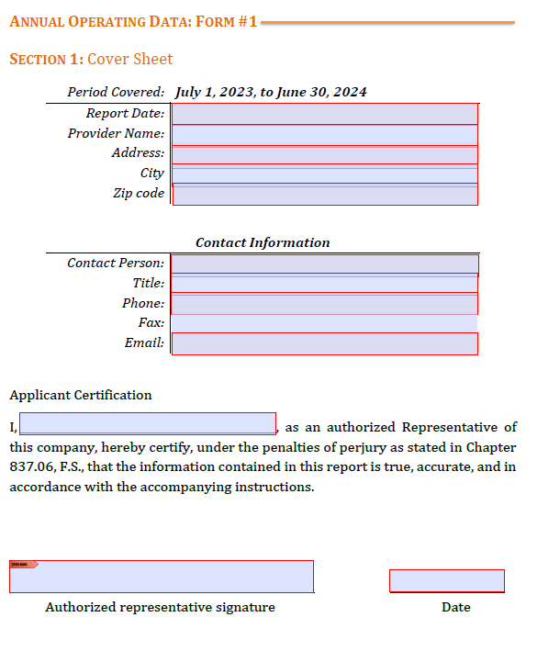
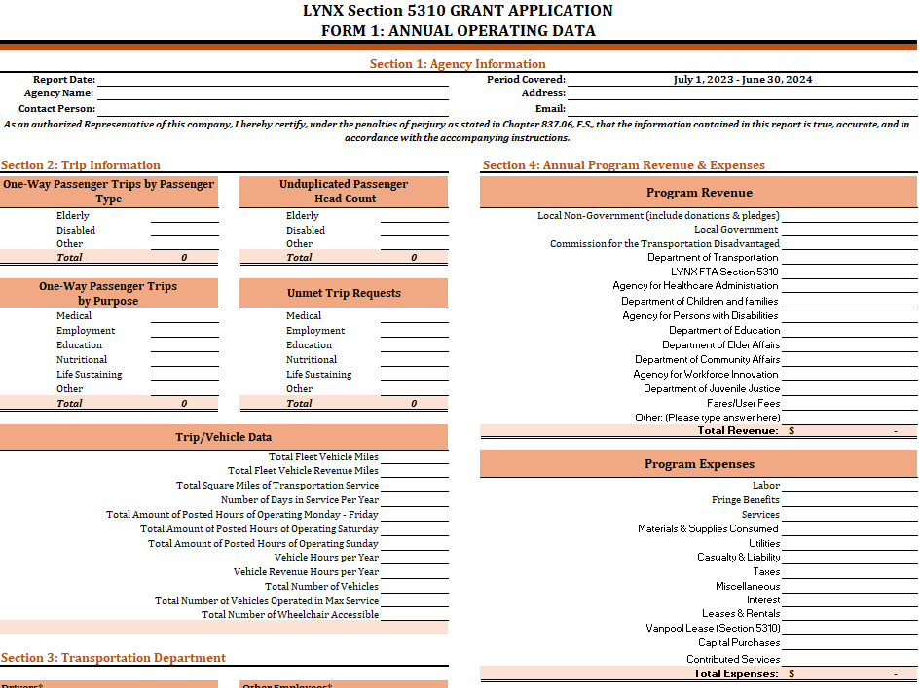
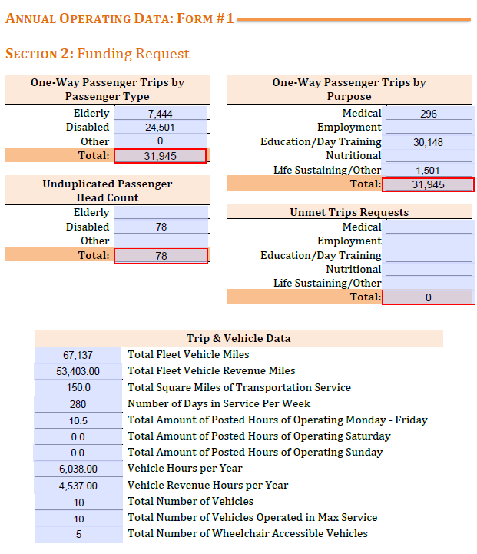
REQUIRED DOCUMENTS: FORM #1
Annual Operating Data
Support for Budget and Fact Sheet including data from July 1, 2023, through June 30, 2024 (Sections 1-4)

Slide 20
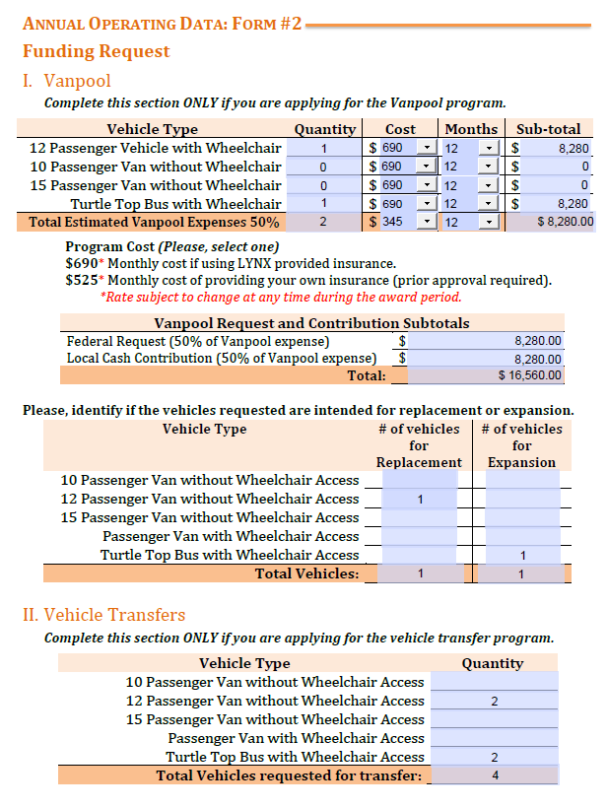
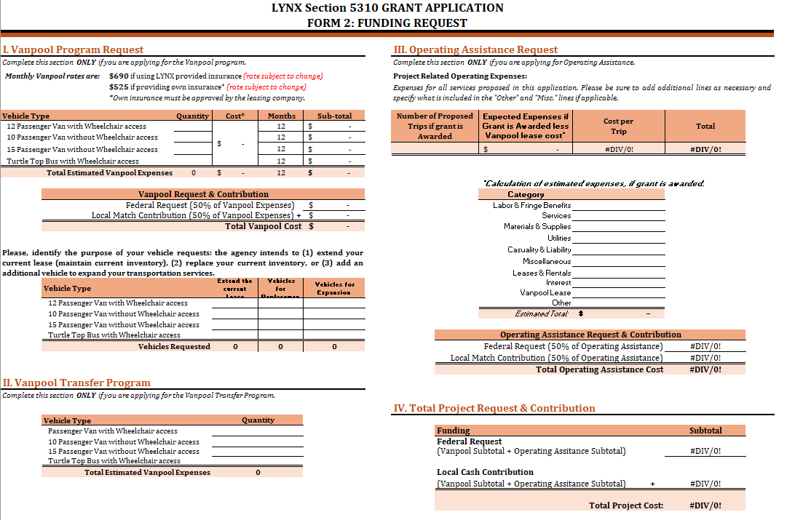
REQUIRED DOCUMENTS: FORM #2
Funding Request
Enter your request for
Vanpool assistance, Operating
Assistance, and Vehicle
Transfers.

Slide 21
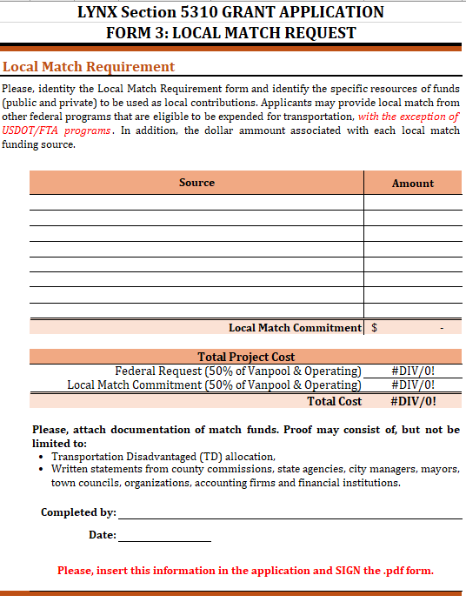
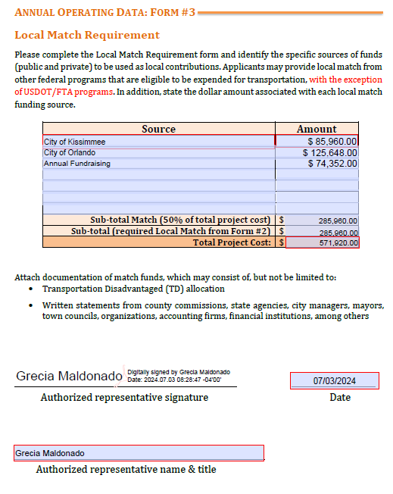
REQUIRED DOCUMENTS: FORM #3
Local Match Requirement
Sources and amounts of Local Match
Other funds received for transportation
Local Cash Contribution amount from Form 2 must match Total Local Match

Slide 22
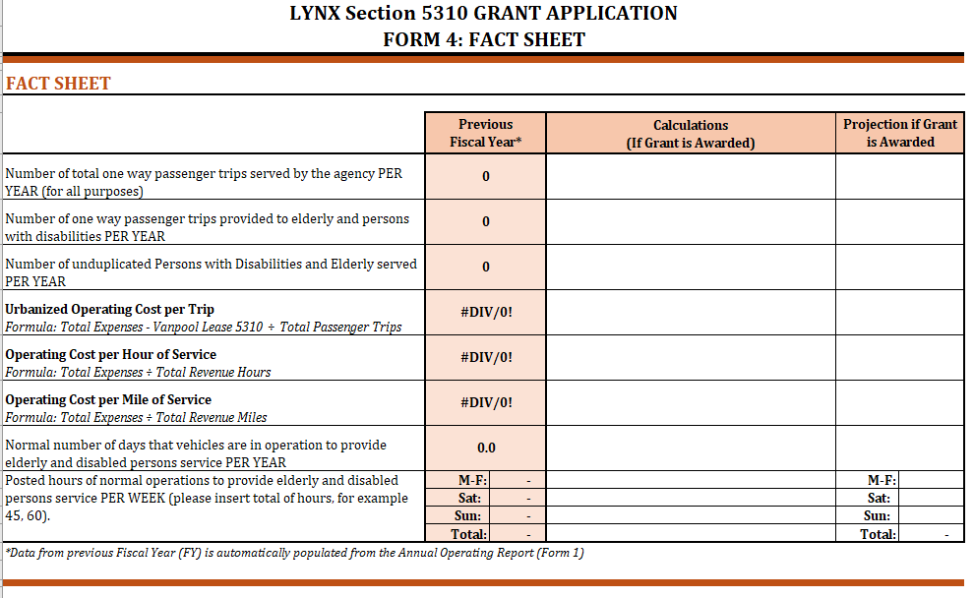
REQUIRED DOCUMENTS: FORM #4
Fact Sheet
1st column – Information from previous fiscal year (provided in Form #1)
2nd column – type your calculations
3rd column – follow your calculation (2nd column)to present your projections if the grant is awarded

Slide 23
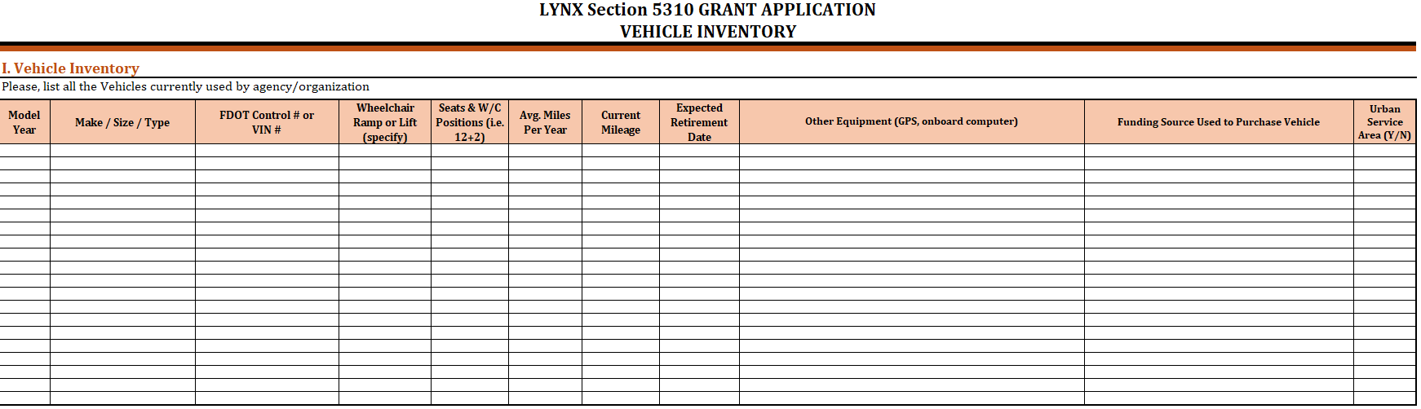
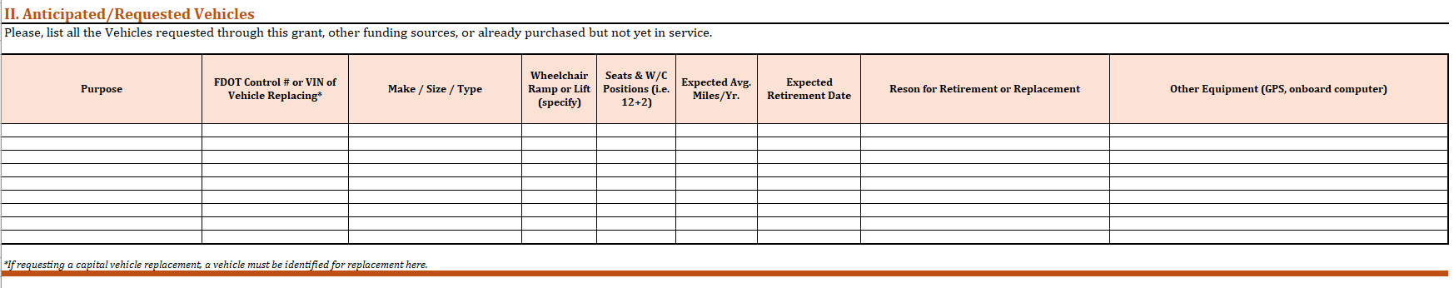
REQUIRED DOCUMENTS: FORM #5
Vehicle Inventory
Please include your current vehicle inventory as well as the anticipated/requested vehicles.

Slide 24

PROJECT SELECTION
Multi-agency:
A multi-agency evaluation committee will review the applications and score them based on the evaluation criteria.
Criteria:
  Documents 22 points max
  Agency Information 2 points max
  System Description 17 points max
  Budget 25 points max
  Proposed Project 29 points max
  Overall Impression 5 points max
  Max Score: 100 points
Internal (LYNX):
Subrecipient risk assessment
Fact Sheet

Slide 25

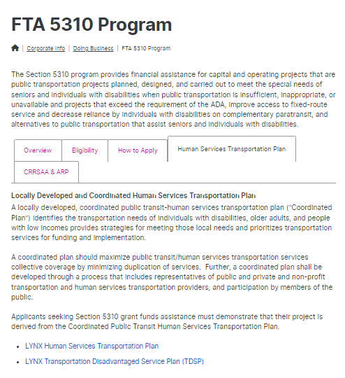
BEST PRACTICES
Read LYNX’s Transportation Disadvantaged Service Plan.
The Authorized Representative signing forms MUST be the same person designated in the Board Resolution.
Do not copy and paste information from a previous application! Show how you have improved.
Maps must be in COLOR and attached to the pdf.

Slide 26

Ctc/5310 hands-on training

Slide 27
contact information
Brenda I Garces
Human Services Transportation Analyst
& Grant Writer
LYNX
BGarces@golynx.com
Luis Benitez
Branch Manager
Commute with Enterprise
luis.benitez@em.com
Selita Stubbs
Senior Manager Mobility Services
CTC – LYNX
SStubbs@golynx.com

Slide 28

LYNX Section 5310 Program
FTA 5310 Program | Public Transportation in Orange, Seminole & Osceola (golynx.com)

